Slide 1
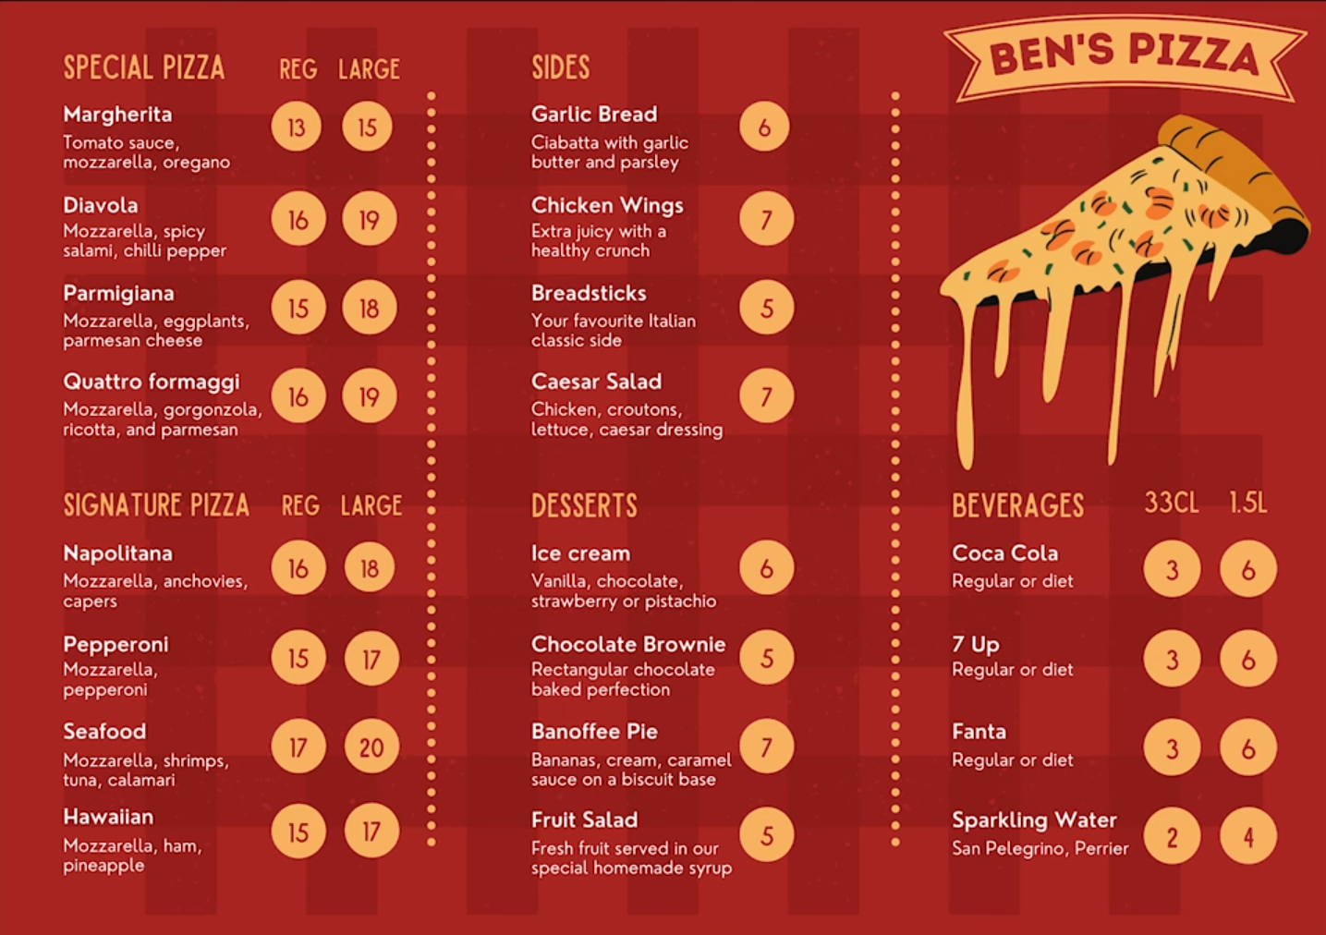
SQL Project
“Ben’s Pizza”

Slide 2
Shortened Menu for the two new stores

Slide 3
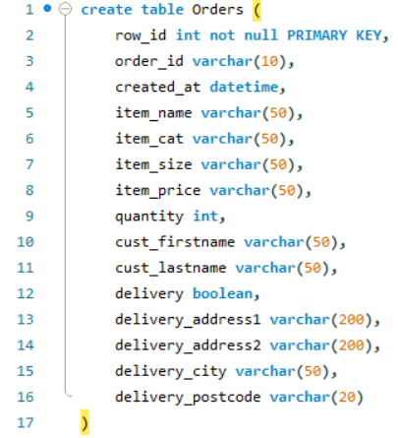
Creating the table
The information collected per order.

Slide 4
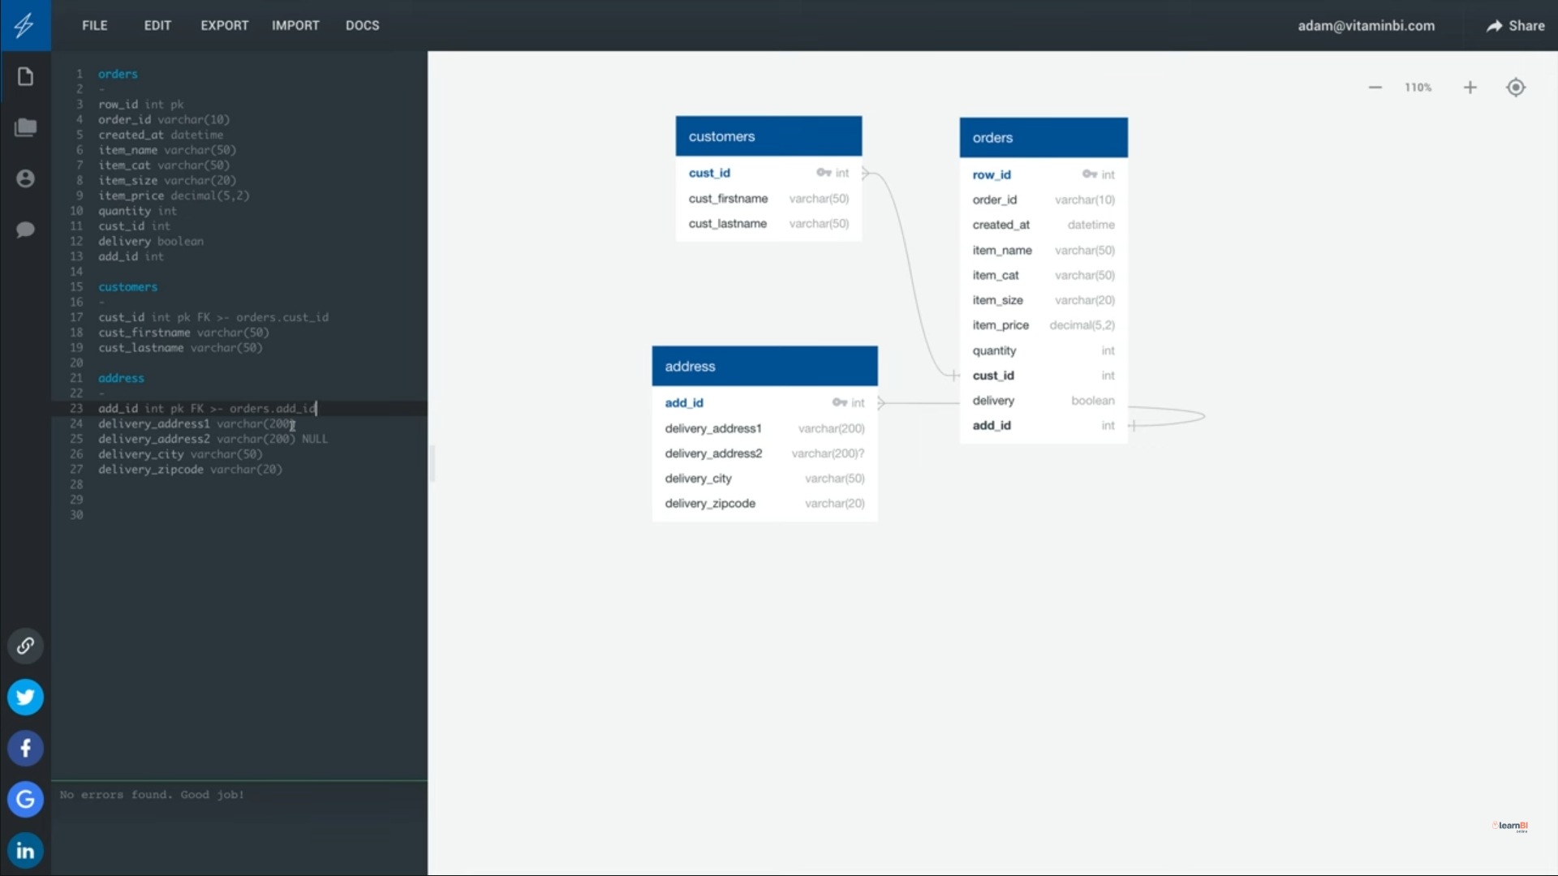
In the video example, he’s using this software to create and link the tables.
I’ve decided to do it myself via MySQL workbench.

Slide 5
Normalisation process
I have the Orders table and all the data it has potentially collected.
It has 15 columns.
I plan to seperate these columns into seperate tables.
New Table 1 will be a 'customers' table, which will take the following columns from orders
cust_firstname
cust_lastname
and be replaced with "cust_id" PRIMARY KEY of 'customer' table
New Table 2 will be 'address' table, which will take the following columns from orders
delivery_address1
delivery address2 (make this potentially NULL)
delivery_city
delivery_postcode
and be replaced with "add_id" PRIMARY KEY of 'address' table
New Table 3 will be Menu Items
Item_name
Item_cat
Item_price
New Table 4 will be orders

Slide 6
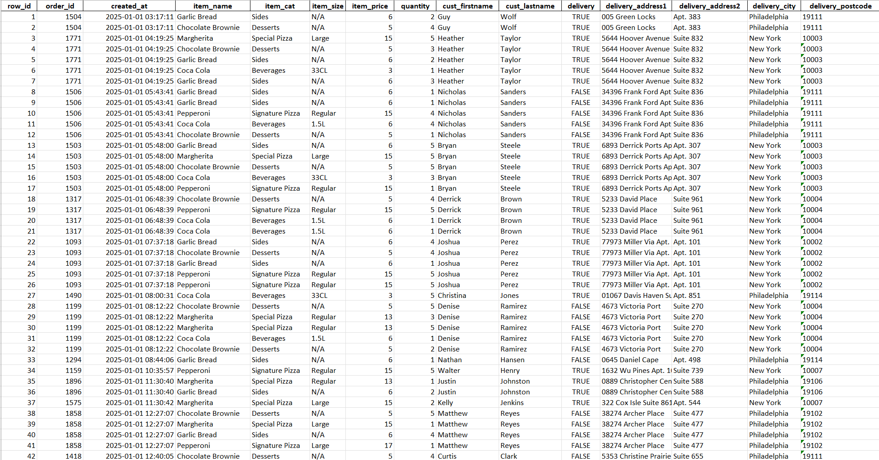
Here’s the data

Slide 7
Checking for duplicates

